Slide 1
GEL 325 Applied Geochemistry 3 Units 2019/2020
Dr. N.M. Waziri

Slide 2
Geochemistry?
It is the study of the:
Chemical composition of the earth and other planets.
Processes and consequences of the distribution of the elements in minerals and rocks in different physical-chemical environments
Cycles of matter and energy that transport the earth's chemical components in space and time
The term geochemistry was coined by a Swiss chemist called Shonbein in 1938; however, modern geochemistry owes its development to V. M. Goldschmidt

Slide 3
Cosmochemistry
Chemistry
Geochemistry
Geology
Bio-
geochemistry
Atmo-
geochemistry
Litho-
geochemistry
Hydro-geochemistry
Figure 1 Branches of Geochemistry and related fields (Modified from Rankama & Sahama, 1950)

Slide 4
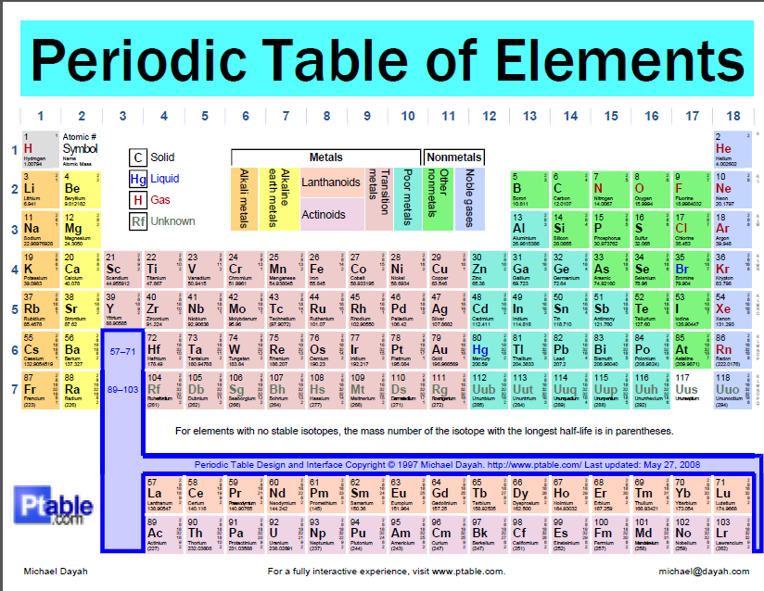
Figure 2 The periodic table of elements

Slide 5
Classification of Elements Based on Abundance
Two schools of thought exist on the classification of elements: one takes minor elements as a class, while the other lumps them with trace elements
Major Elements: constitute the building blocks of all geologic materials like rocks, minerals, soils, water
Mainly eight elements, namely, Na, K, Ca, Mg, Si, Al, O, Fe
In geosciences, those elements constituting up to 0.1 % or 1000 ppm in a system
2. Minor elements, e.g. Ti, Be
3. Trace elements, often, do not affect the physical or chemical properties of a system to a significant extent e.g. Cu, Pb, Zn,
Account for less than 0.1 % in a system
They do not form minerals or phases of their own in a system
Relative term, depending on the system under consideration
Trace element in one system may be major in another (e.g. potassium is a major element continental rocks, but trace in ocean water)

Slide 6
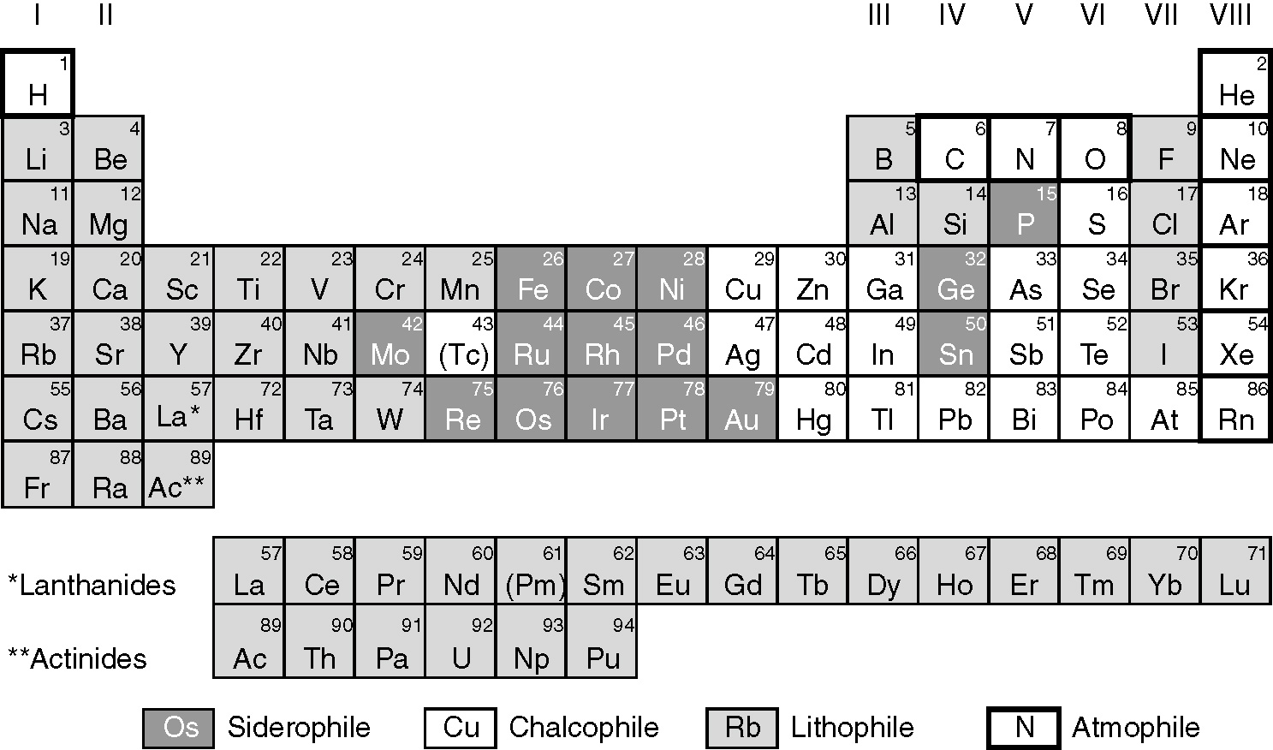
Goldschmidt’s Geochemical classification of elements based on geochemical affinity or behaviour (Albarede, 2009

Slide 7
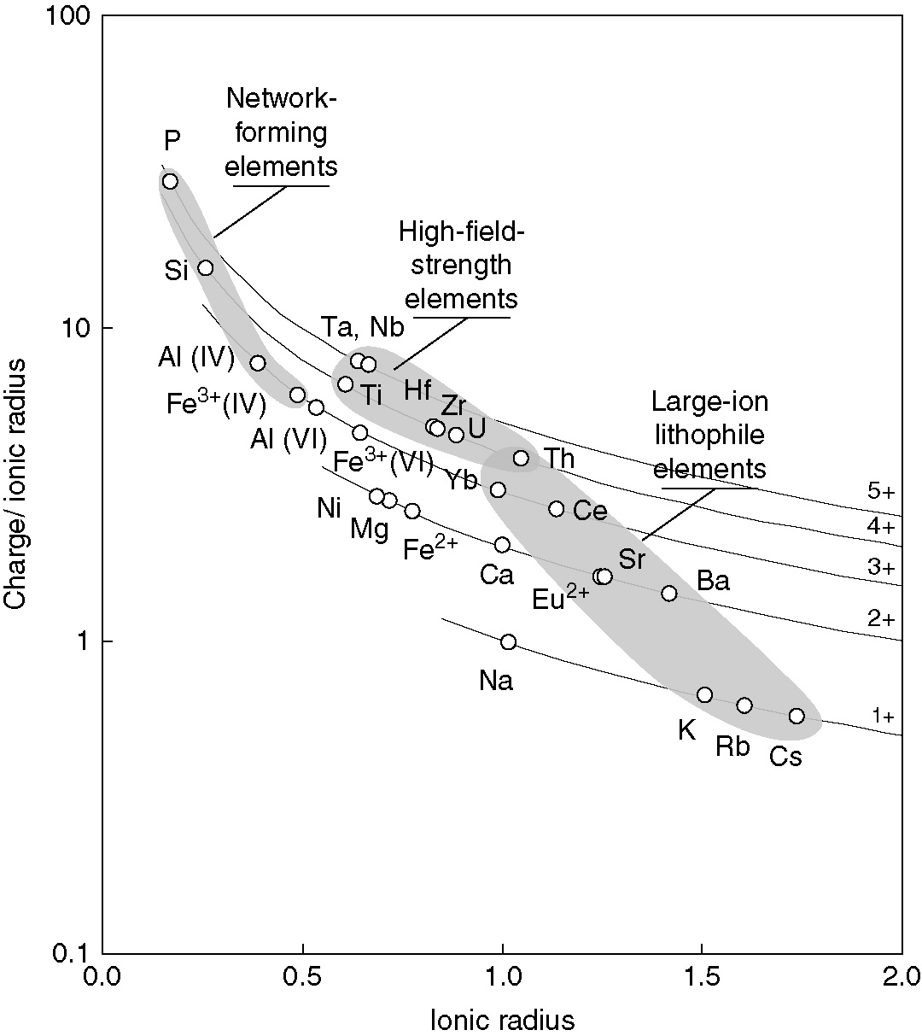
Fig.3 Groups of elements with coherent geochemical behaviour(Albarede, 2009)

Slide 8
Geochemical Environments
System with characteristic temperature & pressure conditions and abundance of chemical components which determine the stability of phases at any given point
On the basis of T, P & chemistry, we have deep-seated and surficial environments
Deep-seated extends from lowest level reached by circulating surface water to the deepest level at which normal rocks can be formed

Slide 9
Geochemical Environments Cont’d
Dominant processes in deep-seated primary environment are magmatism and metamorphism
Typically a high T and P domain, accompanied by restricted circulation of fluids and relatively low free oxygen contents
Surficial environment on the other hand associated with weathering, erosion and sedimentation at (or near) earth’s surface
Low T, P and free movement of solutions and abundant free-oxygen (direct contact with atmosphere)

Slide 10
Geochemical Mobility
Movement of elements from one environment to another or from one part to another within an environment
Often facilitated by the flow of fluids, e.g. Water
It is a response to dispersion processes, and refers to the ease with which elements are translocated relative to the matrix surrounding it
It is the ease with which an element can enter a mobile phase due perhaps, to the effect of physico-chemical conditions of the environment
This varies with the chemistry (stability) of the mineral in which the element is bonded or the physical state of the environment (pH, Eh, organic matter content etc)

Slide 11
Geochemical Mobility Cont’d
An element continues to be mobile until a change in physical & chemical conditions cause its precipitation or incorporation into a solid phase
In deep-seated environments, mobility is a question of enrichment or depletion of an element in specific minerals
For example, high contents of Sn, Sr, & La in micas of pegmatitic stage and depletion in micas of ordinary magmatic processes shows their relative mobility under pegmatitic conditions

Slide 12
Geochemical Mobility Cont’d
In surficial environments, element mobility includes dispersion during weathering, sedimentation and metamorphism
Dominantly transport under aqueous conditions
Mobility in this environment is a function of ionic potential (charge: radius) of elements
low ionic potential elements are soluble and highly mobile as simple cations
Those with moderate potentials are immobile, where those with high potentials are moderately mobile

Slide 13
Fig.3 Groups of elements with coherent geochemical behaviour(Albarede, 2009)

Slide 14
Geochemical Mobility Cont’d
Mobility in the surficial environment is affected by the following
Composition of natural water;
pH & Eh conditions of transmitting medium;
Solubility of minerals hosting the elements;
Adsorption and chemical exchange;
Ionic potential of the elements;
Mineral stability

Slide 15
Geochemical Mobility Cont’d
Mobile elements are useful as pathfinders for mineral deposits, they form wider dispersion patterns
Depends on conditions of the environment, for example Fe³⁺ is mobile in slightly acidic conditions, whereas Al³⁺ is mobile under strongly acidic conditions
Elements like Nb, Ti, Zr are significantly immobile in the surficial environment (leading to their enrichment in soils and sediments)

Slide 16
Geochemical Background, Anomaly & Threshold
Background: normal abundance of an element in an un-mineralized earth material; differing from one sample material to another
Thus expressed as a range, rather than an absolute value even in relatively uniform environments
Certain environmental conditions lead to enrichment of some elements and depletion of others
Useful in recognising patterns due to mineralization or ore deposits

Slide 17
Geochemical Background, Anomaly & Threshold Cont’d
Anomaly: departure from normal abundance or background for a given area or environment
It is a departure from normal chemistry of geological material and may be one or a group of elements
The normal concentration of an element in an ore deposit is relatively abnormal when compared to that in the country rocks
An anomaly therefore is a recognisable pattern of geochemical dispersion associated with an ore body

Slide 18
Geochemical Background, Anomaly & Threshold Cont’d
Anomalies may be positive (enrichment) or negative (depletion)
Anomalies related to mineralization and used as guides to ore deposits are called positive or significant anomalies
Such anomalies consist of values high above the background
Where anomalous concentrations are due to non-economic mineralization, it is termed a non-significant anomaly
False anomalies result from some processes in the surficial environment, such leaching or contamination

Slide 19
Geochemical Background, Anomaly & Threshold Cont’d
Threshold: specific value which effectively separates the high and low concentrations resulting from different sources
Concentration of indicator element above which the material is considered to be anomalous
It is the upper limit of background fluctuations, such that higher values are considered anomalous while lower one are taken background
Recognising the local regional threshold is very important in prospecting as it helps to focus the search to areas with high concentrations

